Slide 1

Problems on Conditional Expectation 2009

Slide 2
Reference
Data
Youtube
Code

Slide 3
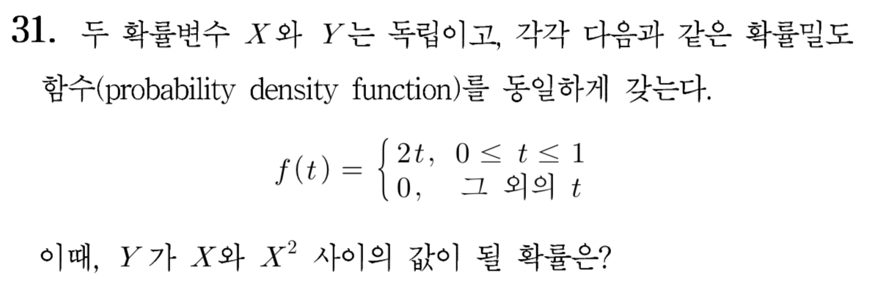
[2009]

Slide 4
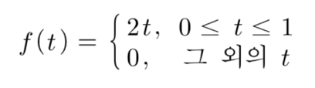

Slide 5


Slide 6
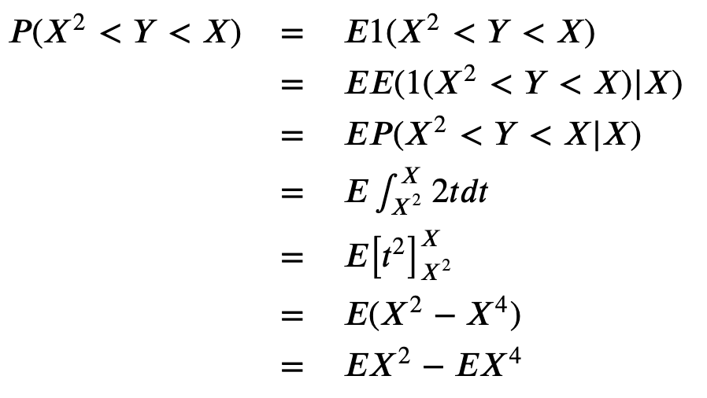

Slide 7


Slide 9


Slide 11
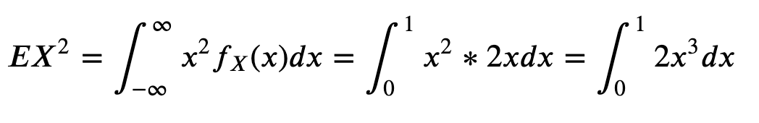

Slide 12
